Slide 1
Nonlinear Dynamical Systems Workshop
Tuesday Afternoon

Slide 2
Overview (1:30)
Finish powerlaw
RQA Metrics
CYO
Discussion
Markov Matrices
State Space Grids
cf Recurrence Plots
Examples
CYO
Comparison: RQA, SSG, and Markov

Slide 3
Finish off Power Law (1:30)
Finish fits and discussions

Slide 4
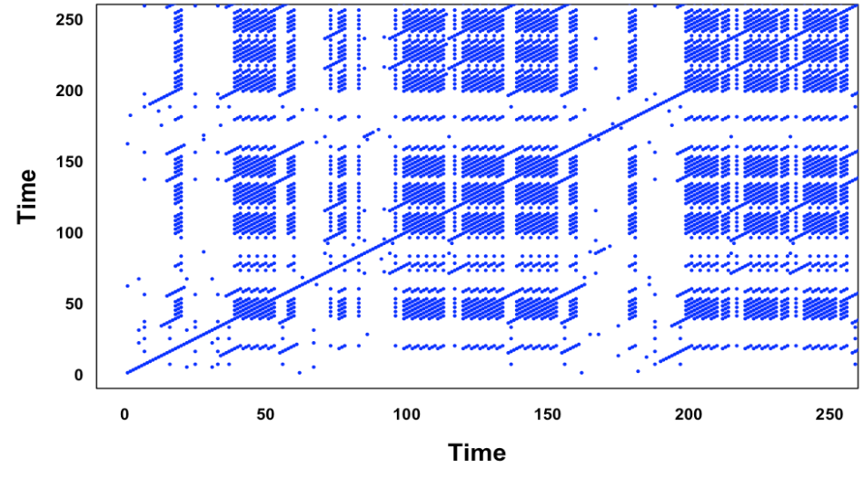
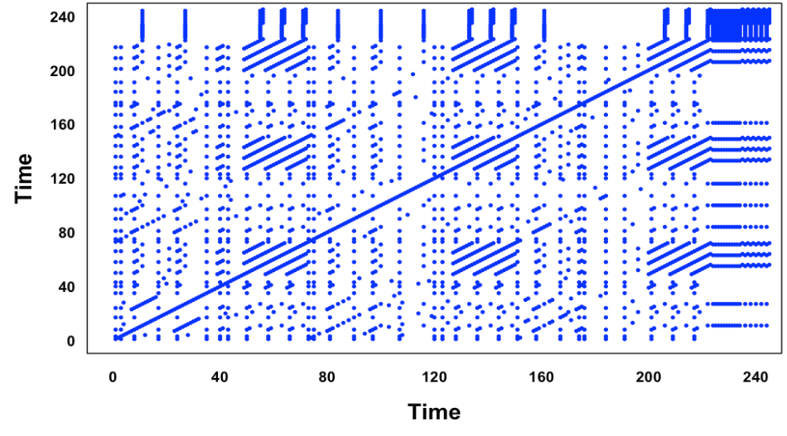
Compare these plots (1:50)

Slide 5
Compare these plots
Beatles’ “Let It Be”
Beatles’ “Revolution”

Slide 6
Recurrence Plot (2:00)
Show their creation
Copy text into text file (create in Rstudio) and save
Look! The right directory!
Cleaning text: prepareText()
Making it happen: crqa()
A gazillion parameters to set…ugh
Eventually we’ll get to things like “phase space reconstruction” and “embedding dimension” and “delay.” Try to ignore them for now
Plotting: plotRP()
Another gazillion parameters to set…ugh
Notes:
RQA example.Rmd has all of the parameters necessary.

Slide 7
Recurrence Quantification Analysis (2:10)
Metrics – 9 common ones
Recurrence Rate (RR) – density of recurrence points
Determinism (DET) – predictability from long diagonals
NRLINE – total number of diagonal lines
maxL or L_{max} – longest diagonal line
L – average diagonal line length (mean prediction time)
ENTR – Shannon entropy
rENTR – entropy normalized by number of lines
LAM – proportion of points forming vertical lines
TT – average length of vertical lines
We’ll look at these in detail after lunch
Notes:
Need to do each of these and annotate them in the file.

Slide 8
RP Metric Interpretations (1)
Recurrence Rate (RR)
Percent of dots (not including LOI)
Determinism (DET)
Fraction of recurrent points that form diagonal lines (>l_{min})
NRLINE
Total number of diagonal lines
Notes:
Bootstrapping ci in package

Slide 9
RP Metric Interpretations (1a)
Recurrence Rate (RR)
Percent of dots (not including LOI)
Determinism (DET)
Fraction of recurrent points that form diagonal lines (>l_{min})
NRLINE
Total number of diagonal lines
Notes:
Connect all these to RP
Bootstrapping ci in package

Slide 10
RP Metric Interpretations (2)
L_{max} (or D_{max})
Longest diagonal line
L (or D)
Average diagonal line
“Average time two segments of the trajectory are close to each other” (Marwan & Webber, 2015)

Slide 11
RP Metric Interpretations (2a)
L_{max} (or D_{max})
Longest diagonal line
L (or D)
Average diagonal line
“Average time two segments of the trajectory are close to each other” (Marwan & Webber, 2015)

Slide 12
RP Metric Interpretations (3)
Entropy (ENTR or ENT)
Shannon entropy (of diagonal line lengths); a measure of complexity and/or surprise
Normalized Entropy (rENTR)
Entropy divided by number of diagonal lines
More on entropy later

Slide 13
RP Metric Interpretations (3a)
Entropy (ENTR or ENT)
Shannon entropy (of diagonal line lengths); a measure of complexity and/or surprise
Normalized Entropy (rENTR)
Entropy divided by number of diagonal lines
More on entropy later

Slide 14
RP Metric Interpretations (4)
Laminatiry (LAM)
Percent of recurrent points in vertical lines (> l_{min})
Trapping Time (TT)
Average length of vertical lines
Notes:
The cheat sheet should have a high and low value RP for each metric.

Slide 15
RP Metric Interpretations (4a)
Laminatiry (LAM)
Percent of recurrent points in vertical lines (> l_{min})
Trapping Time (TT)
Average length of vertical lines
Notes:
The cheat sheet should have a high and low value RP for each metric.

Slide 16
RP Metric Interpretations (5)
Not calculated by crqa::crqa()
Can do each of the above as a function of distance to LOI
Useful for looking at periodicity
Trend (TND)
Regress RR on distance to LOI
Information about stationarity (TND near 0) vs. nonstationarity (TND far from 0)

Slide 17
RP Metric Interpretations (5a)
Not calculated by crqa::crqa()
Can do each of the above as a function of distance to LOI
Useful for looking at periodicity
Trend (TND)
Regress RR on distance to LOI
Information about stationarity (TND near 0) vs. nonstationarity (TND far from 0)

Slide 18
RP Metric Interpretations (6a)
Not calculated by crqa::crqa()
Maximum vertical line (V_{max})
Stuckness – results in rectangles
And more…see Marwan & Webber (2015)

Slide 19
Words are categories! (2:40)
When considering truly categorical data, generally fewer unique values than when considering words
Example: NDSMacro1
Might want to change parameters (mindiagline, minvertline)
CYO
NDSMacro2 (or your own data; ideally two different sequences)
Compare the NDSMacro1 metrics to the NDSMacro2 metrics
Discussion: Convince your partner why your interpretation is correct

Slide 20
RP Metrics: CYO (2:45)
Data: Categorical data
NDSMacro2
Macrocognitive codes (Ricca et al, 2020)
Same group, different day from NDSMacro1
Compare the metrics with each other; do they make sense?

Slide 21
Break (3:00)
We’ll pick up at 3:10

Slide 22
Markov Matrices (3:10)
Transition Probabilities (code i to code j)
Makes a matrix
These matrices are also one representation of networks
Matrix from NDSSpeakers (speakers of NDSMacro1)
Sequence: SKSSB SBKBS SKSKS BDSBS BDSSS BSBBS SBK
Matrix:
Caution: Sometimes transition matrices are written as the transpose
 | B | D | K | S
B | 0.10 | 0.20 | 0.20 | 0.50
D | 0.00 | 0.00 | 0.00 | 1.00
K | 0.25 | 0.00 | 0.00 | 0.75
S | 0.50 | 0.00 | 0.19 | 0.31

Slide 23
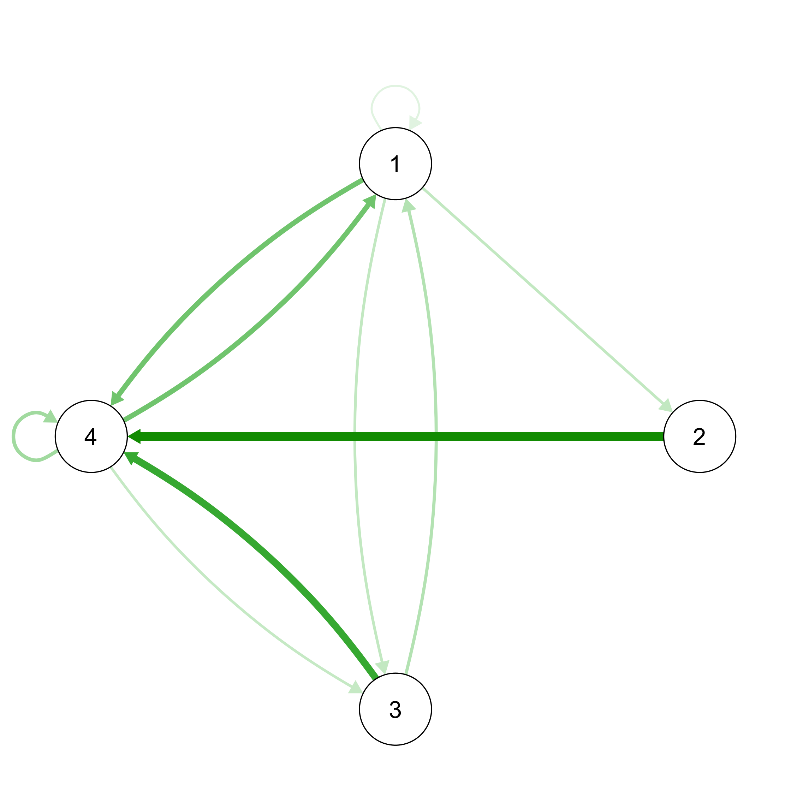
Plotting Transition Networks (3:15)
Matrix
Relative to the transitions from each node!
Transition Plot
 | 1 | 2 | 3 | 4
1 | 0.10 | 0.20 | 0.20 | 0.50
2 | 0.00 | 0.00 | 0.00 | 1.00
3 | 0.25 | 0.00 | 0.00 | 0.75
4 | 0.50 | 0.00 | 0.19 | 0.31

Slide 24
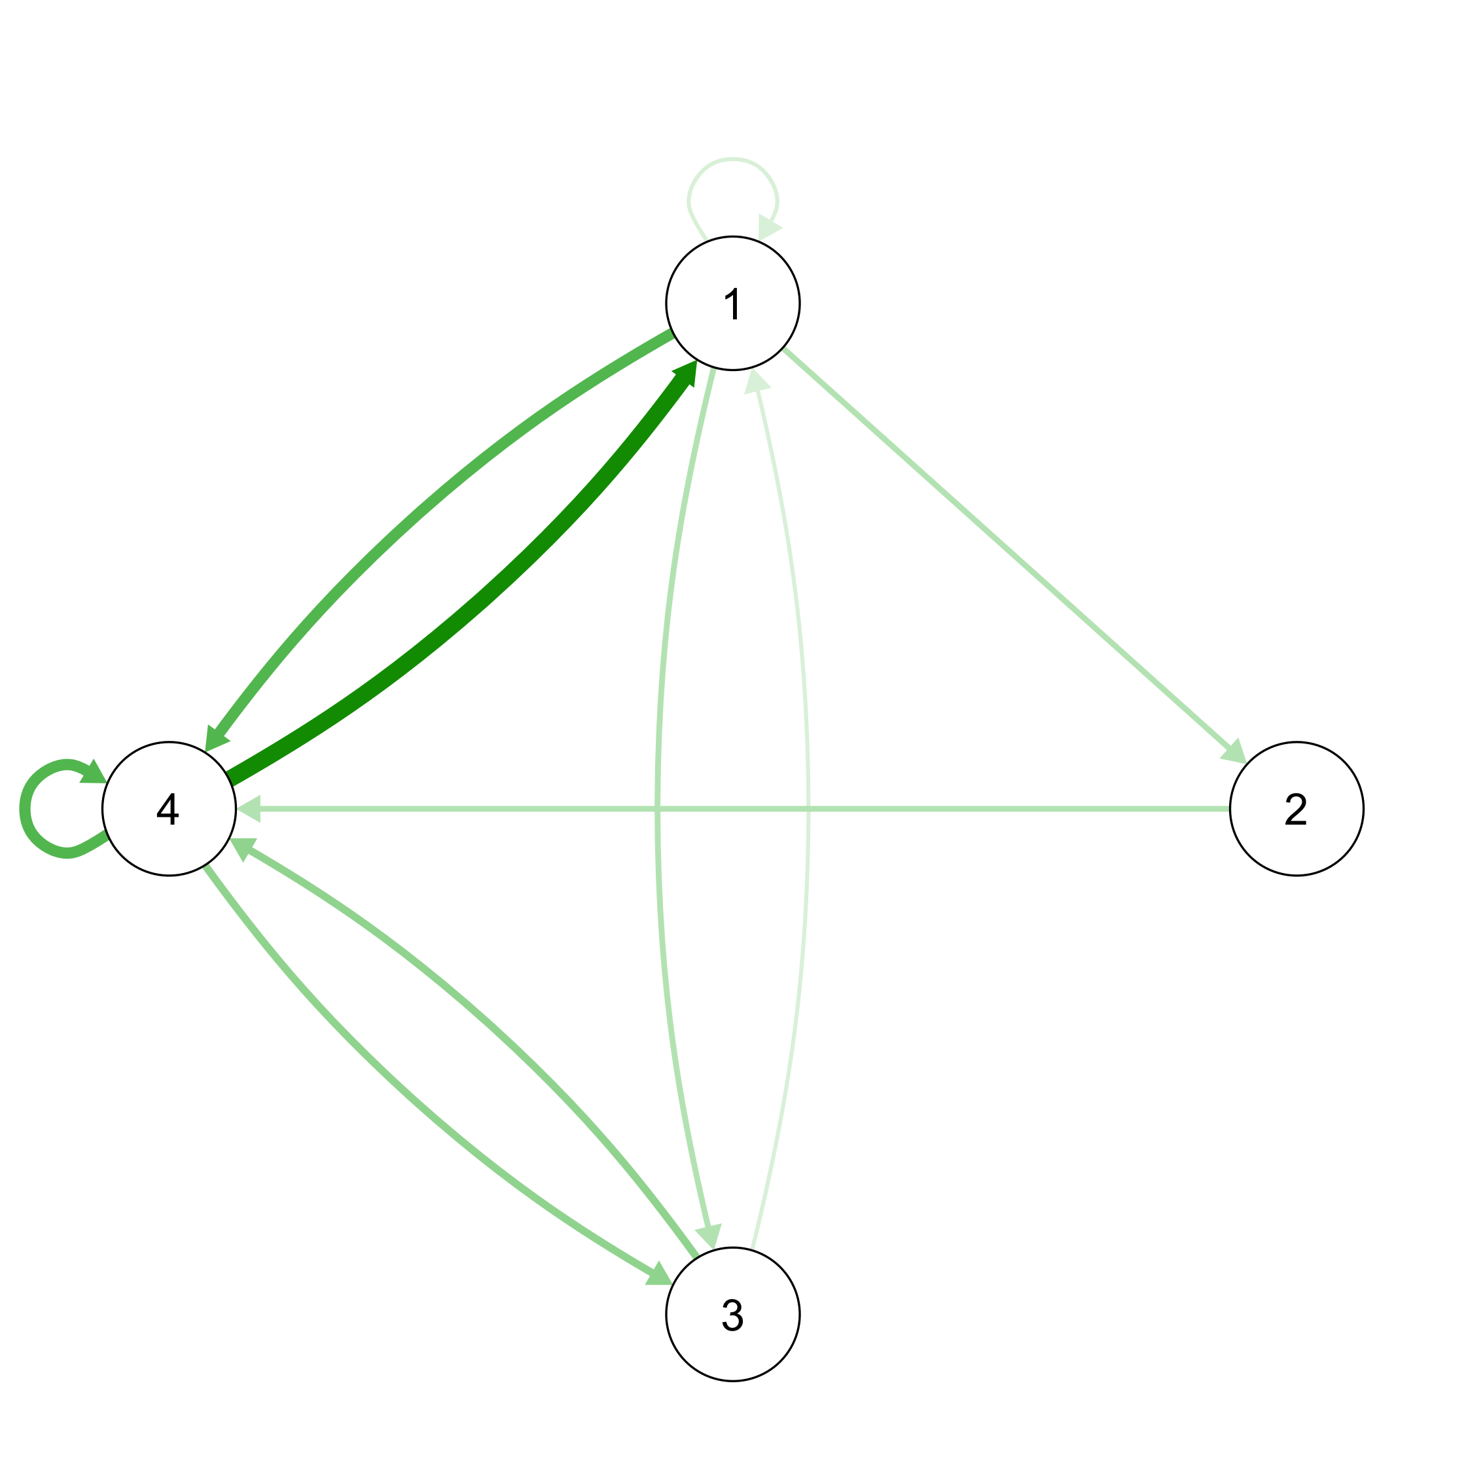
Plotting Transition Networks (Alternate)
Matrix
Relative to the total number of transitions, not each node!
Transition Plot
 | 1 | 2 | 3 | 4
1 | 0.03 | 0.06 | 0.06 | 0.16
2 | 0.00 | 0.00 | 0.00 | 0.06
3 | 0.03 | 0.00 | 0.00 | 0.09
4 | 0.25 | 0.00 | 0.09 | 0.16

Slide 25
Creating Markov matrices (3:25)
Make the transition matrix:
makeMarkov(pull(read.csv("https://bit.ly/NDSMacro1"))
Plot the transition matrix:
qgraph(makeMarkov(pull(read.csv("https://bit.ly/NDSMacro1")),
layout = “circle”)
Issue
Is one step enough to capture the dynamics? (Strelioff et al, 2007)
Don’t go here if you don’t have to…the math is ugly and I’m not sure I get it yet.

Slide 26
CYO (3:30)
Data: NDSMacro2
Compare to NDSMacro1
We’ll look at inference issues later in the week

Slide 27
The Three Alternatives (3:55)
Patterns (at mesoscales)
RQA
OD
Histories (Dynamics plus context)
State space grids (coming soon!)
RQA to some extent
Dynamics
Markov (assuming transitions capture dynamics)
Same dynamics can lead to many histories
Notes:
Really, can do inference with any of these via resampling; it is just harder with RQA and SSG.

Slide 28
Issues Involving the Three Alternatives
Later this week
Inference (via bootstrapping)
Clustering
What do you want to investigate, and why?
Dynamics, patterns, histories
Where do covariates fit in?

Slide 29
{Context + Dynamics} (if time)
Dynamics abstracted from Empirical Situation 1 |  |  | Dynamics abstracted from Empirical Situation 1
Empirical Situation 1 {Context 1 + Dynamics} |  |  | Empirical Situation 2 {Context 2 + Dynamics}
Abstract the dynamics
Apply the dynamics
Generalization?

Slide 30
Royall (Chapter 1; 1997) (if time)
“Consider a physician’s diagnostic test for the presence or absence of some disease, D. Suppose that experience has shown the test to be a good one, rarely producing misleading results. Specifically, the performance of the test is described by the probabilities shown” here:
 | Positive Test | Negative Test
Disease Present | 0.95 | 0.05
Disease Absent | 0.02 | 0.98

Slide 31
Royall (Chapter 1; 1997) (if time)
 | Positive Test | Negative Test
Disease Present | 0.95 | 0.05
Disease Absent | 0.02 | 0.98
“Now suppose that a patient, Mr Doe, is given the test. On learning that the result is positive,” what would your conclusion be?
“Mr Doe probably does not have D.”
“Mr Doe should be treated for D.”
“The test result is evidence that Mr Doe has D.”

Slide 32
Royall (Chapter 1; 1997) (if time)
Number 1 can true too!
Suppose the disease is very rare (e.g., 1% of the population)
 |  | 10000 people
100 with disease |  |  | 9900 without disease
95 positive tests | 5 “false negatives” |  | 198 “false positives” | 9702 negative tests

Slide 33
Repository of this week (4:20)
Repository of everything: https://barneyricca.github.io/NDSWorkshop
This includes the data files
This includes the PPTX files, so you have some notes if you need them
This includes the scripts I write (posted after I write them)
But don’t peek
You’ll learn more if you don’t peek ahead of time
Besides, entries may be edited during the workshop

Slide 34
State Space Grids (if time)

Slide 35
State Space Grids (SSG) (2:15)
Categorical time series data
Categories on the axes, not time series
Focus on the categories, not the time
Example: NDSMacro1
ssg(pull(read.csv("https://bit.ly/NDSMacro1")))
ssg_metrics(pull(read.csv("https://bit.ly/NDSMacro1")))
Ugh…choose only some of the values

Slide 36
CYO SSG (2:30)
Use these data or your own
NDSMacro2
NDSTeacher1 (from Heleen Pennings)
NDSTeacher2 (from Heleen Pennings)
Discussion
Compare NDSMacro2 to NDSMacro1
Compare NDSTeacher1 to NDSTeacher2
Compare SSG results to RQA results

Slide 37
Wrapping Up (4:25)
Please take the two-question survey
Give one good thing about today’s sessions
Give one thing that could have improved today’s sessions
Link: http://bit.ly/NDSTuesdaySurvey

